Slide 2
Actions
to grow your
UnFranchise and
Shopping Annuity

Slide 3
EXPECTED RESULTS
Ongoing Residual Income
Time Freedom
Your Lifestyle
Make A Difference For Others

Slide 4
Result Producing Activities
Use and Sell the Products
Share the Business
Share the Shopping Annuity
Sell Tickets (Education)

Slide 5
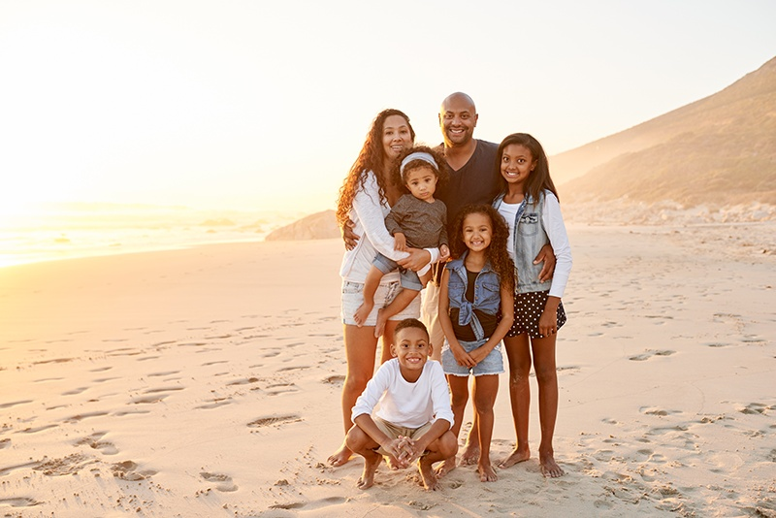
Begin with the end in mind!

Slide 6
Use and Share Products

Slide 7
What is the “end result” of Use and Sell Products?
Build Customer Base
Great Customer Manager
Generate Revenue

Slide 8
How to use and sell products…
Convert products in your household to Market Australia products!
Have products with you at all time!
Share Your story!
Leverage Social Media
Products Party, Wellness 101, Motives®, TLS®

Slide 9
Implement and Share The Shopping Annuity

Slide 10
What is the “end result” of Sharing the Shopping Annuity?
Convert Spending Into Earnings
Expend Customers Base
Increase Revenue
Business Become Natural and Easier
Identify Business Partners and Increase Efficiency

Slide 11
How to share the Shopping Annuity…
Changing your own shopping habits
Build and expand share of customer
Convert other people’s spending to complete MUFO
Share and duplicate

Slide 12
Share the Business

Slide 13
What is the “end result” of Sharing the Business?
Expand The Distribution Channels To Increase Revenue
Increase Market Shares
Create A Team Of Entrepreneurs

Slide 14
How to share The Business…
STEP 1: Build Relationships
STEP 2: Make Calls (Call Workshop)
STEP 3: Book Appointments
STEP 4: Show The Plan
STEP 5: Follow Up’s
STEP 6: Start Partnership

Slide 15
STEP 1: Build Relationships
Make friends
Increase your names list by adding 2 new prospects on daily basis
Don’t force the conversation, build the relationship

Slide 16
STEP 2: Make Calls
Reality: People fail in the business simply because they fail to make calls
Call Workshops
MAKE THE CALLS

Slide 17
STEP 3: Book Appointments
Leverage Your Senior Partners
Leverage The System

Slide 18
STEP 4: Show the Plan
Use the tools: Flip Chart, PowerPoint, webinars,HBP, UBP, Product events, etc.
Ask questions to find dreams or pain
Use mini closes that are a solution to their dreams or pain.
Book another appointment!

Slide 19
STEP 5: Follow Ups
Answer questions
Provide solutions
Get their answer, partner or customer?
Book another appointment

Slide 20
STEP 6: Start Partnership
Book 2-3 hours to get started, Getting Started Guide, book events
Match up with their commitment
Introduce them to the team
Plug them into the system, GMTSS
Teach and Duplicate

Slide 21
Sell Tickets / Education

Slide 22
What is the “End Result” of Sell Tickets?
Education
Understand Market Australia’s MPCP
You Are Paid By GBV
BV is Searched Infinitely
BV Is 100% Accrued 100%
NO Break Away
Hours of Education in a Condensed Time Frame

Slide 23
What is the “End Result” of Sell Tickets?
Help Partners To Develop Entrepreneurs‘ Mindset
Help Partners To Develop Necessary Skills
Help Partners To Build Successful Habits
Nurture Team Spirit
Promote Partnership
Get The Entire Team Educated and Trained To Maximize People Power
Condense their learning curve
As A Team, We Can Change The World

Slide 24
How To Sell Tickets…
Buy Tickets
Show Up
Have Regular Home Events
Participate In The Team Events: ABC Pattern
Meeting After Meeting

Slide 25
How To Sell Tickets…
Only after we develop the habit of buying tickets, our team will duplicate us.
Our success in Shop.com is determined by our entire team’s education level!

